Slide 1
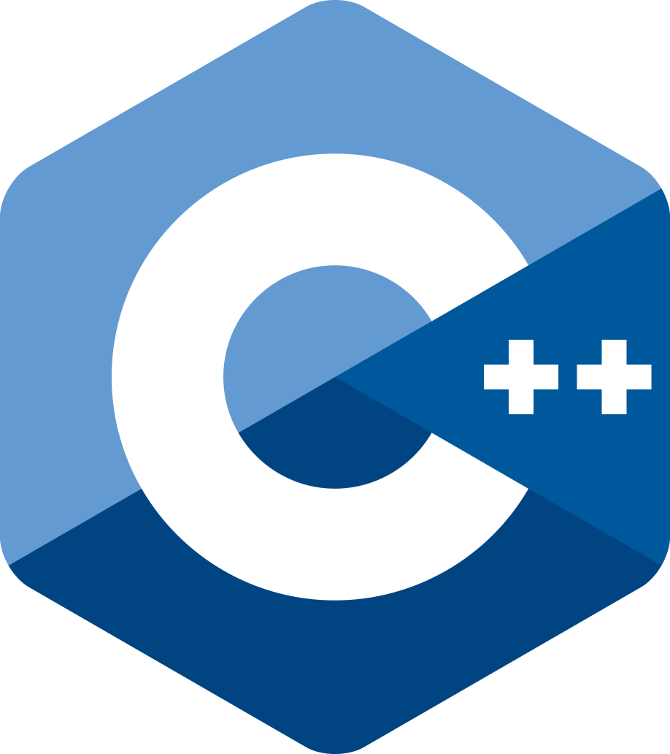

Modern C++ Course
Gammasoft

Slide 2

Who am I ?
Gammasoft
Gammasoft aims to make c++ fun again.
About
Gammasoft is the nickname of Yves Fiumefreddo.
More than thirty years of passion for high technology especially in development (c++, c#, objective-c, ...).
Object-oriented programming is more than a mindset.
more info see my GitHub : https://github.com/gammasoft71
Gammasoft
Modern C++ Course

Slide 3
Outline
Introduction
Language Basics
Object Oriented Programming (OOP)
Core Modern C++
Modern C++ Expert
Advanced Programming
Gammasoft
Modern C++ Course

Slide 4
Outline
Introduction
Language Basics
Object Oriented Programming (OOP)
Core Modern C++
Modern C++ Expert
Advanced Programming
Gammasoft
Modern C++ Course

Slide 5
Introduction
Introduction
What this course is?
History
Wy using C++?
References
C++ development tools
Gammasoft
Modern C++ Course

Slide 6
Introduction
Introduction
What this course is?
History
Wy using C++?
References
C++ development tools
Gammasoft
Modern C++ Course

Slide 7
What this course is?
Introduction | What this course is?
Gammasoft
Modern C++ Course

Slide 8
What this course is?
Introduction | What this course is?
Gammasoft
Modern C++ Course
This course aimed at inexperienced developers as well as experienced developers with no knowledge of Modern C++.

Slide 9
What this course is?
Introduction | What this course is?
Gammasoft
Modern C++ Course
This course aimed at inexperienced developers as well as experienced developers with no knowledge of Modern C++.
This course covers concepts from C++98 to C++23, while keeping modern C++ in mind.

Slide 10
What this course is?
Introduction | What this course is?
Gammasoft
Modern C++ Course
This course aimed at inexperienced developers as well as experienced developers with no knowledge of Modern C++.
This course covers concepts from C++98 to C++23, while keeping modern C++ in mind.
The corresponding C++ version is indicated for each concept and feature.
Notes:
Dans le coin supérieur gauche

Slide 11
Introduction
Introduction
What this course is?
History
Wy using C++?
References
C++ development tools
Gammasoft
Modern C++ Course

Slide 12
Introduction
Introduction
What this course is?
History
Wy using C++?
References
C++ development tools
Gammasoft
Modern C++ Course

Slide 13
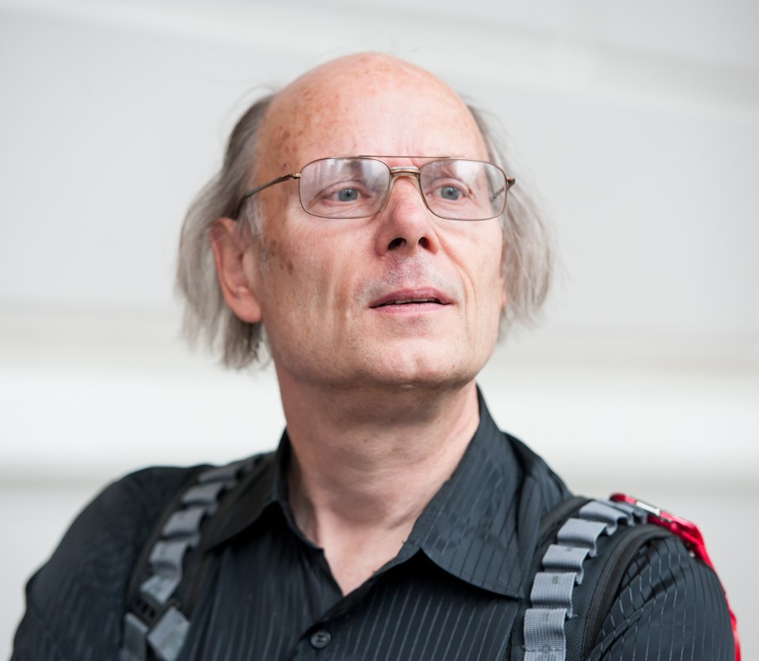
Bjarne Stroupstrup
Introduction | History
Bjarne Stroustrup, a Danish computer scientist, is the creator of C++.
Gammasoft
Modern C++ Course

Slide 14
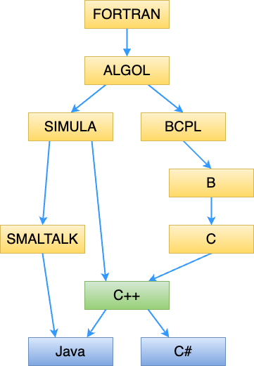
C++ language
Introduction | History
In 1979, Bjarne Stroustrup began work on "C with Classes", the predecessor to "C++".
In 1982, Stroustrup started to develop a successor to "C with Classes", which he named "C++".
In 1985, the first edition of The C++ Programming Language was released
In 1998, C++98 was released, standardizing the language
Gammasoft
Modern C++ Course
Notes:
1954 : FORTRAN 1972 : SMALTALK
1958 : ALGOL 1979 -> 1998 : C++
1967 : SIMULA / BCPL 1994 : Java
1969 : B 2002 : C#
1971 : C

Slide 15
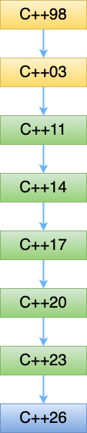
C++ Standards
Introduction | History
1998 | 14882:1998 | C++98
2003 | 14882:2003 | C++03
2011 | 14882:2011 | C++11
2014 | 14882:2014 | C++14
2017 | 14882:2017 | C++17
2020 | 14882:2020 | C++20
2024 | 14882:2024 | C++23
TBA | | C++26
Gammasoft
Modern C++ Course

Slide 16
Introduction
Introduction
What this course is?
History
Wy using C++?
References
C++ development tools
Gammasoft
Modern C++ Course

Slide 17
Introduction
Introduction
What this course is?
History
Wy using C++?
References
C++ development tools
Gammasoft
Modern C++ Course

Slide 18
Adapted to large projects
Introduction | Why using C++?
Gammasoft
Modern C++ Course

Slide 19
Adapted to large projects
Introduction | Why using C++?
Statically and strongly typed
Gammasoft
Modern C++ Course

Slide 20
Adapted to large projects
Introduction | Why using C++?
Statically and strongly typed
Object oriented
Gammasoft
Modern C++ Course

Slide 21
Adapted to large projects
Introduction | Why using C++?
Statically and strongly typed
Object oriented
Widely used (and taught)
Gammasoft
Modern C++ Course

Slide 22
Adapted to large projects
Introduction | Why using C++?
Statically and strongly typed
Object oriented
Widely used (and taught)
Many available libraries
Gammasoft
Modern C++ Course

Slide 23
Adapted to large projects
Introduction | Why using C++?
Statically and strongly typed
Object oriented
Widely used (and taught)
Many available libraries
Many available documentations and examples on the net
Gammasoft
Modern C++ Course

Slide 24
Fast
Introduction | Why using C++?
Gammasoft
Modern C++ Course

Slide 25
Fast
Introduction | Why using C++?
unlike some other languages (Java, C#, Python, ...) C++ is compiled to native machine code
Gammasoft
Modern C++ Course

Slide 26
Fast
Introduction | Why using C++?
unlike some other languages (Java, C#, Python, ...) C++ is compiled to native machine code
close to hardware when needed
Gammasoft
Modern C++ Course

Slide 27
What we get?
Introduction | Why using C++?
Gammasoft
Modern C++ Course

Slide 28
What we get?
Introduction | Why using C++?
The most powerful language
Gammasoft
Modern C++ Course

Slide 29
What we get?
Introduction | Why using C++?
The most powerful language
The most complicated one
Gammasoft
Modern C++ Course

Slide 30
What we get?
Introduction | Why using C++?
The most powerful language
The most complicated one
The most error prone?
Gammasoft
Modern C++ Course

Slide 31
Introduction
Introduction
What this course is?
History
Wy using C++?
References
C++ development tools
Gammasoft
Modern C++ Course

Slide 32
Introduction
Introduction
What this course is?
History
Wy using C++?
References
C++ development tools
Gammasoft
Modern C++ Course

Slide 33
Books
Introduction | References
Gammasoft
Modern C++ Course

Slide 34
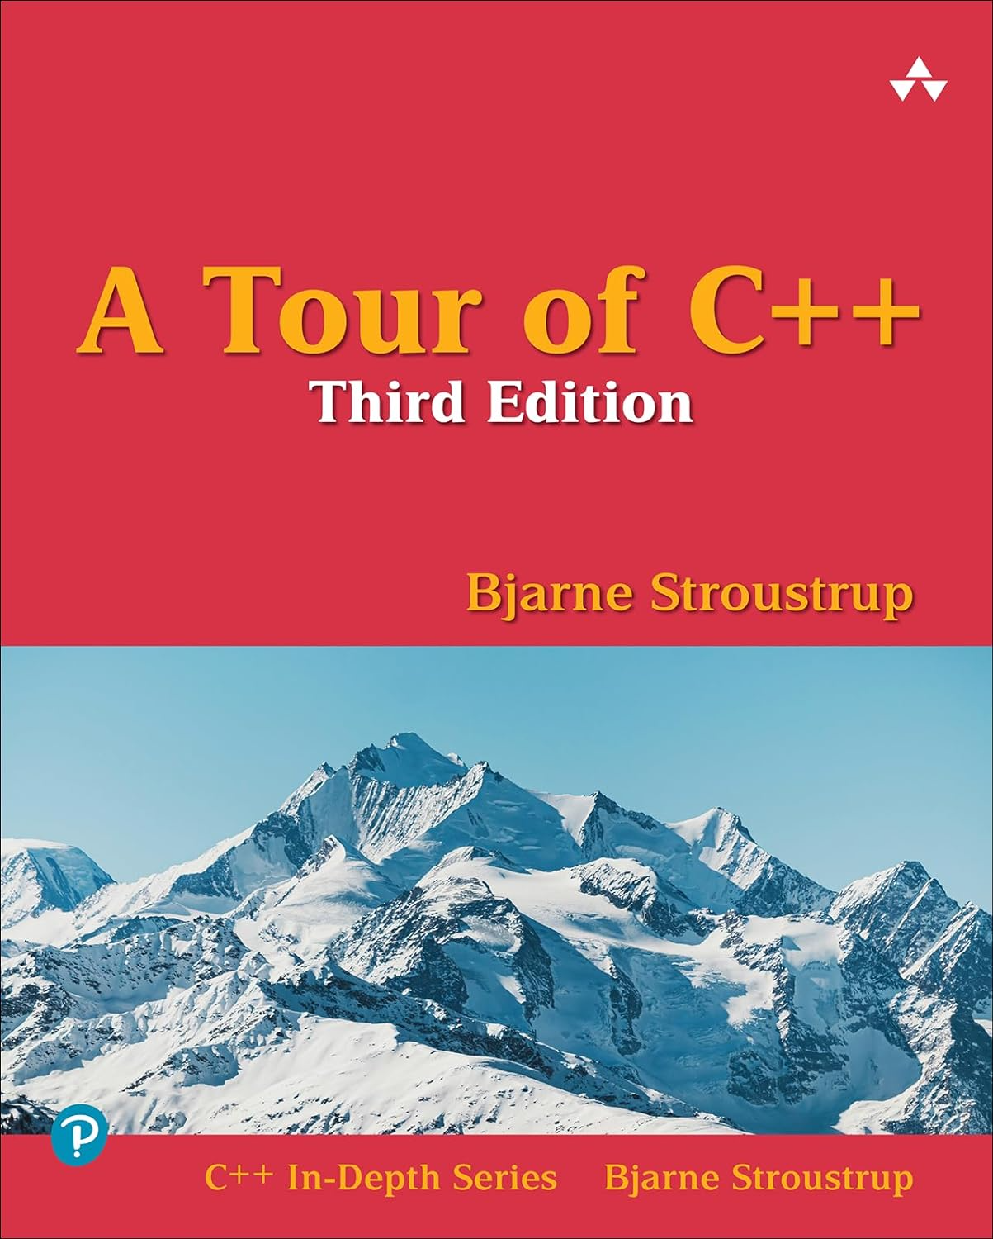
Books
Introduction | References
Gammasoft
Modern C++ Course

Slide 35
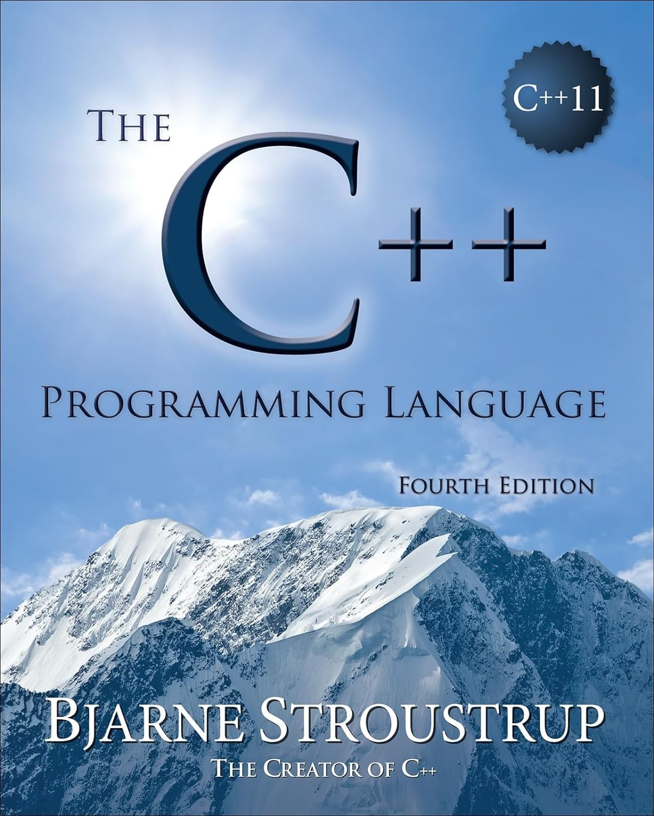
Books
Introduction | References
Gammasoft
Modern C++ Course

Slide 36
Useful links
Introduction | References
Gammasoft
Modern C++ Course

Slide 37
Useful links
Introduction | References
https://isocpp.org
Gammasoft
Modern C++ Course

Slide 38
Useful links
Introduction | References
https://isocpp.org
https://cppreference.com
Gammasoft
Modern C++ Course

Slide 39
Useful links
Introduction | References
https://isocpp.org
https://cppreference.com
https://github.com
Gammasoft
Modern C++ Course

Slide 40
Useful links
Introduction | References
https://isocpp.org
https://cppreference.com
https://github.com
https://stackoverflow.com
Gammasoft
Modern C++ Course

Slide 41
Useful links
Introduction | References
https://isocpp.org
https://cppreference.com
https://github.com
https://stackoverflow.com
https://www.programmingalgorithms.com
Gammasoft
Modern C++ Course

Slide 42
Useful links
Introduction | References
https://isocpp.org
https://cppreference.com
https://github.com
https://stackoverflow.com
https://www.programmingalgorithms.com
And more...
Gammasoft
Modern C++ Course

Slide 43
Introduction
Introduction
What this course is?
History
Wy using C++?
References
C++ development tools
Gammasoft
Modern C++ Course

Slide 44
Introduction
Introduction
What this course is?
History
Wy using C++?
References
C++ development tools
Gammasoft
Modern C++ Course

Slide 45
Compilers
Introduction | C++ development tools
C++ | GCC | Clang | MSVC | Apple Clang
11 | >= 4.8 | >= 3.3 | >= 19 | >= 3.3
14 | >= 4.9 | >= 3.4 | >= 19 | >= 3.3
17 | >= 7.3 | >= 5 | >= 19.01 | >= 10
20 | >= 11 | >= 19 | >= 19.29 | >= 15
23 | >= 15 | >= 19 | >= 19.40 | >= 15
Gammasoft
Modern C++ Course

Slide 46

CMake
Introduction | C++ development tools
Gammasoft
Modern C++ Course

Slide 47
CMake
Introduction | C++ development tools
Single source builds on multiple platforms
Gammasoft
Modern C++ Course

Slide 48
CMake
Introduction | C++ development tools
Single source builds on multiple platforms
Accurate dependencies and minimal rebuilds
Gammasoft
Modern C++ Course

Slide 49
CMake
Introduction | C++ development tools
Single source builds on multiple platforms
Accurate dependencies and minimal rebuilds
Out-of-source builds
Gammasoft
Modern C++ Course

Slide 50
CMake
Introduction | C++ development tools
Single source builds on multiple platforms
Accurate dependencies and minimal rebuilds
Out-of-source builds
Cross-platform packaging system
Gammasoft
Modern C++ Course

Slide 51
CMake
Introduction | C++ development tools
Single source builds on multiple platforms
Accurate dependencies and minimal rebuilds
Out-of-source builds
Cross-platform packaging system
Cross-platform testing system
Gammasoft
Modern C++ Course

Slide 52
CMake
Introduction | C++ development tools
Single source builds on multiple platforms
Accurate dependencies and minimal rebuilds
Out-of-source builds
Cross-platform packaging system
Cross-platform testing system
And more...
Gammasoft
Modern C++ Course

Slide 53
Integrated Development Environment (IDE)
Introduction | C++ development tools
Gammasoft
Modern C++ Course

Slide 54

Integrated Development Environment (IDE)
Introduction | C++ development tools
Microsoft Visual Studio (Windows)
Gammasoft
Modern C++ Course

Slide 55

Integrated Development Environment (IDE)
Introduction | C++ development tools
Microsoft Visual Studio (Windows)
Xcode (macOS)
Gammasoft
Modern C++ Course

Slide 56

Integrated Development Environment (IDE)
Introduction | C++ development tools
Microsoft Visual Studio (Windows)
Xcode (macOS)
Microsoft Visual Studio Code (Windows, macOS and Linux)
Gammasoft
Modern C++ Course

Slide 57




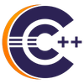


Integrated Development Environment (IDE)
Introduction | C++ development tools
Microsoft Visual Studio (Windows)
Xcode (macOS)
Microsoft Visual Studio Code (Windows, macOS and Linux)
and others
Gammasoft
Modern C++ Course

Slide 58

Configure your development environment
Introduction | C++ development tools
Gammasoft
Modern C++ Course

Slide 59
Configure your development environment
Introduction | C++ development tools
Install compiler
Gammasoft
Modern C++ Course

Slide 60
Configure your development environment
Introduction | C++ development tools
Install compiler
Install IDE (according to OS)
Gammasoft
Modern C++ Course

Slide 61
Configure your development environment
Introduction | C++ development tools
Install compiler
Install IDE (according to OS)
Install CMake
Gammasoft
Modern C++ Course

Slide 62
Configure your development environment
Introduction | C++ development tools
Install compiler
Install IDE (according to OS)
Install CMake
Install SCM like git (not mandatory)
Gammasoft
Modern C++ Course

Slide 63
Configure your development environment
Introduction | C++ development tools
Install compiler
Install IDE (according to OS)
Install CMake
Install SCM like git (not mandatory)
Subscribe to GitHub (not mandatory)
Gammasoft
Modern C++ Course

Slide 64
Introduction
Introduction
What this course is?
History
Wy using C++?
References
C++ development tools
Gammasoft
Modern C++ Course

Slide 65
Introduction
Introduction
What this course is?
History
Wy using C++?
References
C++ development tools
Gammasoft
Modern C++ Course

Slide 66
Outline
Introduction
Language Basics
Object Oriented Programming (OOP)
Core Modern C++
Modern C++ Expert
Advanced Programming
Gammasoft
Modern C++ Course

Slide 67
Outline
Introduction
Language Basics
Object Oriented Programming (OOP)
Core Modern C++
Modern C++ Expert
Advanced Programming
Gammasoft
Modern C++ Course

Slide 68
Outline
Introduction
Language Basics
Object Oriented Programming (OOP)
Core Modern C++
Modern C++ Expert
Advanced Programming
Gammasoft
Modern C++ Course

Slide 69
Outline
Introduction
Language Basics
Object Oriented Programming (OOP)
Core Modern C++
Modern C++ Expert
Advanced Programming
Gammasoft
Modern C++ Course

Slide 70
Outline
Introduction
Language Basics
Object Oriented Programming (OOP)
Core Modern C++
Modern C++ Expert
Advanced Programming
Gammasoft
Modern C++ Course

Slide 71
Outline
Introduction
Language Basics
Object Oriented Programming (OOP)
Core Modern C++
Modern C++ Expert
Advanced Programming
Gammasoft
Modern C++ Course

Slide 72
Outline
Introduction
Language Basics
Object Oriented Programming (OOP)
Core Modern C++
Modern C++ Expert
Advanced Programming
Gammasoft
Modern C++ Course

Slide 73
Outline
Introduction
Language Basics
Object Oriented Programming (OOP)
Core Modern C++
Modern C++ Expert
Advanced Programming
Gammasoft
Modern C++ Course

Slide 74
Outline
Introduction
Language Basics
Object Oriented Programming (OOP)
Core Modern C++
Modern C++ Expert
Advanced Programming
Gammasoft
Modern C++ Course

Slide 75
Outline
Introduction
Language Basics
Object Oriented Programming (OOP)
Core Modern C++
Modern C++ Expert
Advanced Programming
Gammasoft
Modern C++ Course

Slide 76
Outline
Introduction
Language Basics
Object Oriented Programming (OOP)
Core Modern C++
Modern C++ Expert
Advanced Programming
Gammasoft
Modern C++ Course

Slide 77
Outline
Introduction
Language Basics
Object Oriented Programming (OOP)
Core Modern C++
Modern C++ Expert
Advanced Programming
Gammasoft
Modern C++ Course

Slide 78
End
Gammasoft
Modern C++ Course

